Slide 1
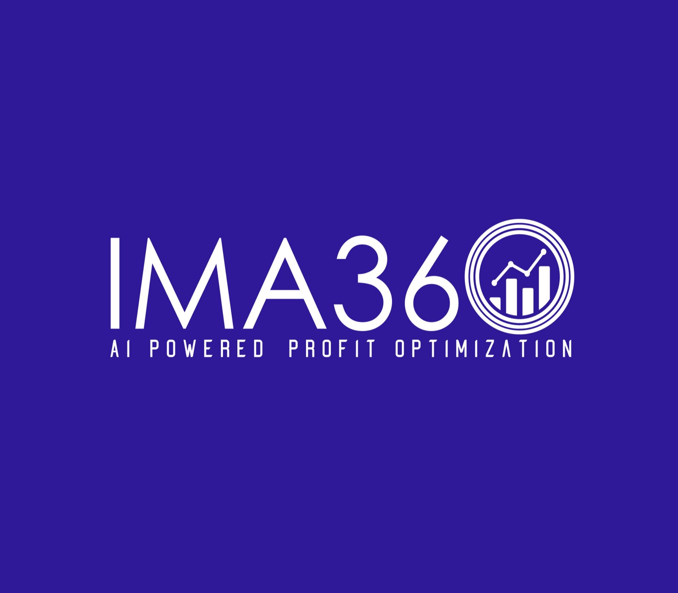
How to Streamline Your Rebate Process with Customer Rebate Management Tools
https://ima360.com/

Slide 2
In today's highly competitive market It's common for businesses to offer discounts to attract and retain customers. But effectively managing a rebate program can be challenging without the right tools. Customer discount management software is essential to improving this process. To be confident in the correctness and maximize the impact of the discount. Here's how you can use these tools to optimize your discounting process.
1. Centralized Rebate Data Management
One of the main challenges businesses face is tracking discounts across multiple channels, departments, or customer segments. The customer rebate management tool is a centralized platform where all discount related information is stored and accessed in real time. This integration ensures consistency across your discount programs. Eliminate errors caused by manual processes. and increase decision-making ability With everything in one place You can manage and analyze discount claims. Easily track progress
2. Automation for faster processing
One of the most important benefits of using customer rebate management software is automation. Many manual tasks, such as data entry Discount calculation and communication with customers Can be automatic This will help expedite the processing of exemption claims and reduce time spent on administrative work. Automation not only improves operational efficiency; But it also reduces human error. This ensures that discounts are processed correctly and efficiently. This allows your team to focus on high-value tasks like analyzing discount performance and optimizing promotional strategies.

Slide 3
3. Enhanced Transparency and Communication
Customer rebate management tools provide transparency by clearly showing the status of rebate claims. Businesses and customers can easily track the progress of their discounts. Strengthen trust and improve customer satisfaction The software usually has a client portal where users can view claim status. Download required documents and send additional information when necessary. This level of transparency improves communication and reduces the need for manual follow-up. This saves time and effort.
4. Promotion Optimization Integration
Effectively optimizing your promotions is important to ensure that discount offers align with your business's pricing strategy. Discount management tools often integrate seamlessly with promotion optimization software. Helping businesses Discount offers can be customized based on real-time market data and customer behavior. By analyzing purchasing patterns and competitive pricing strategies, businesses can design more targeted and effective discount programs. This will drive sales and maximize ROI.
5. Real-time analytics and reporting
Customer discount management tools provide valuable insights through real-time analytics and reporting. These features help businesses measure the effectiveness of their discount programs and understand the impact of promotions. that has an effect on sales and profitability You can track key performance indicators (KPIs) such as redemption rates. Price per discount and the overall success of your promotional optimization strategy. With this information You can quickly adjust your discount program to improve results and ensure consistency with your competitive pricing strategy.

Slide 4
6. Compliance and Auditing
An important aspect of discount management is compliance with internal policies and external regulations. Discount management software often has built-in compliance features that help businesses comply with industry standards and regulations. Additionally, automated tracking and reporting tools make auditing easier. This is because these tools create a detailed account of all discount transactions. This reduces the risk of non-compliance and improves the audit process.
Conclusion
Improving your discount process with a customer discount management tool can greatly improve efficiency, accuracy, and profitability. With automatic manual work Promotion Optimization and provide transparency These tools help ensure that discount programs run smoothly and efficiently. Integrating customer discount management with promotional optimization and competitive pricing strategies. It helps businesses stay ahead of the market by providing valuable incentives to their customers.

Slide 5
Contact Us
Feel free to contact us for any questions and doubts​ on
https://ima360.com/
Phone No:
+1 214-584-6660
Email Address:
info@ima360.com
Head Office:
6600 Chase Oaks Blvd. Ste. 150, Plano, TX 75023

